Slide 1
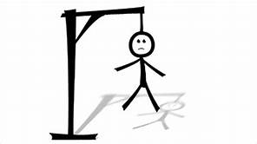
HANGMAN PROJECT
Team - 4

Slide 2
TEAM MEMBERS:
AREPALLI LAKSHMI SAI TEJA - 20B01A0507
AVALA DEEPTHI - 20B01A0508
BOJJAPU CHANDRA JYOTHI - 20B01A0414
BOLLA ARATHI SRAVYA - 20B01A0415
ANDE VIJAYA PRIYA - 20B01A0305

Slide 3
HANGMAN INTRODUCTION
Hangman is a paper and pencil guessing game for two or more players.
One player (Chooser)thinks or choose a secret word and another player (guesser)attempts to guess the word by guessing one letter at a time.
RULES :
1. The chooser draws a number of dashes equivalent to the number of letters in the word.

Slide 4
2.If guessed letter appears in word ,all instances of it are
revealed.
3.If not guesser loses a chance, and chooser starts to
draw hangman.
4. The guesser lost chances are tracked using a stick figure drawing of person being hanged from a gallows.
5. The figure is drawn one body part at a time.
6. The guesser loses when the entire figure has been drawn.

Slide 5
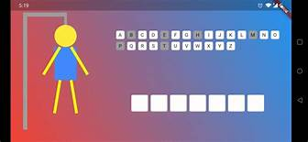
7.The guesser wins the game if he completes answering the word before the limited incorrect chances.
8.Tools used are PyCharm IDE.

Slide 6
DAY TO DAY WORKS
DAY-1 :
We the members of team understood the description of the project and divided the work between us.
DAY-2 :
We practically acknowledged about the game through some websites and created git link and then started to build the code using python software tools.
We completed the basic design like importing the modules(turtle,random,time)and initialization of turtle.
DAY-3 :
We completed the design of draw Man function module of the project and included all the hangman drawings.
We designed a module to repeat the game again.

Slide 7
DAY-4:
Documentation is done for every line of the code for better understanding.
Execution of the code is done and then debugging of bugs are done
Code is verified by the mentors whether it is executing correctly or not and then corrections are made.
DAY -5:
Presentation is given ,and every line of code is explained step by step by all team members of the project .
Project is submitted.

